Slide 1
Digital AND technology solutions Apprenticeship End Point Assessment
Assessor training overview
Dr Craig Gallen Eng.D MIEE, C.Eng
Senior Lecturer Computing

Slide 2
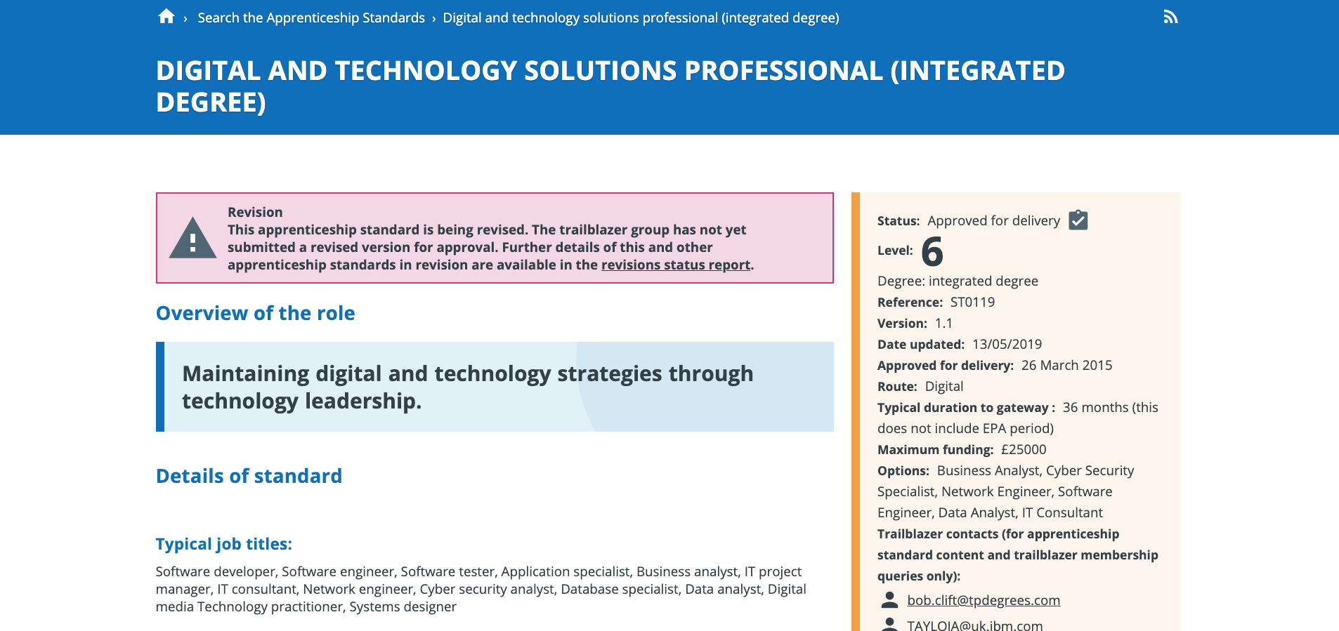
1. FAMILIARISE YOURSELF WITH THE APPRENTICE STANDARD
https://www.instituteforapprenticeships.org/apprenticeship-standards/digital-and-technology-solutions-professional-integrated-degree/

Slide 3
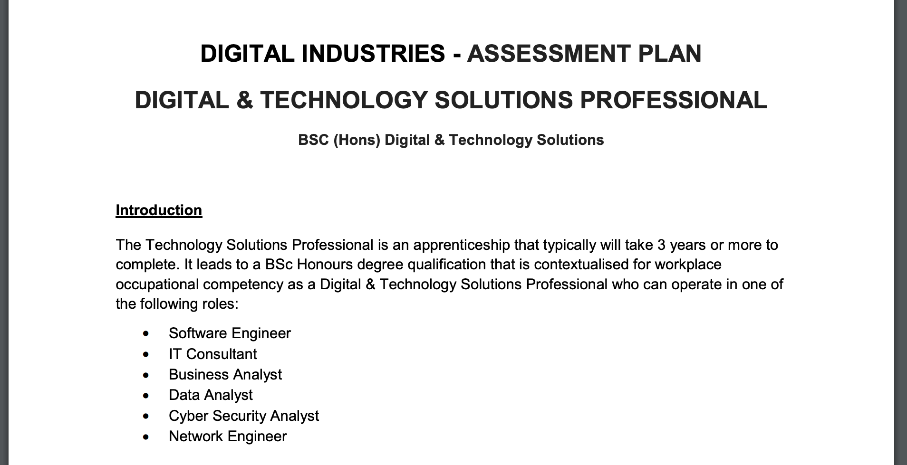
DIGITAL INDUSTRIES - ASSESSMENT PLAN
https://www.instituteforapprenticeships.org/media/1073/digital_and_technology_solutions_professional.pdf

Slide 4
2. REVIEW THE CANDIDATE'S PORTFOLIO
Satisfy yourself that the portfolio is properly graded and review the Synoptic Project
Read the Project and identify several questions or discussion points which align with the assessment plan and a wider awareness of the context of he work
The technical marking will already have been done on programme – you just need to think about questions which will address the 'in work' aspects of the apprentice training.

Slide 5
3. CONDUCT INTERVIEW (1 HOUR MAX.)
Candidate presentation (25-30 mins)
Questions and answers (10-15 mins)
Employer feedback/discussion (10-15 mins)

Slide 6
4. WRITE REPORT
The report template can help you position the questions and answers as evidence of your assessment.

Slide 7
OVERVIEW VIDEO
https://solent.cloud.panopto.eu/Panopto/Pages/Viewer.aspx?id=e74f4700-a340-43a5-9c75-ad7901445d2a

